Slide 1

TDD
Notes:
Show DiscountCalculators, ask what it does
Line 20 of DiscountCalculator1 is even unreachable
Based on real-life code
Show tests and how both classes do the same
Ask what TDD means to everyone
DiscountCalculator example was easy to refactor and add tests afterwards; not always the case. That’s why we write tests first. Then they’re already baked in.

Slide 2
Accompanying GitHub repository
https://github.com/petermorlion/TddCourse

Slide 3

Technique
Red
Green
Refactor!
Notes:
Why Red first?
Forces you to think about design
You will only write what you need
If test is green immediately, the test is wrong (see javascript example on https://petermorlion.com/why-your-test-should-fail-first/)
Writing tests afterwards will be harder
Green with only code that is necessary!
Don’t forget to refactor!
I realize this isn’t always an option in legacy projects, but that’s a different topic entirely

Slide 4

Mocking
Notes:
Rhino Mocks anyone?
Add service for sending email when calculating discount

Slide 5
Dependency Injection
Without
App
Compile time & runtime
(reference & usage)
DiscountCalculator
EmailService

Slide 6
Dependency Injection
Traditional
App
IEmailService
Compile time & runtime
(reference & usage)
DiscountCalculator
EmailService

Slide 7
Dependency Injection
Inversion of Control
DiscountCalculator
App
IEmailService
Compile time
Runtime
EmailService
Notes:
Without, you get transitive dependencies: a chain of dependencies no longer under your control
Show App Code

Slide 8
How much mocking?
A lot? (ie mockist , London)
Notes:
+ simple
+ drives loosely coupled design
- Can lead to Tautological TDD (unnecessary repetition): your tests knows too much about the internal workings of the unit. More work when implementation changes. Hard to refactor because tests need to be refactored too

Slide 9
How much mocking?
Only boundaries of the layer? (ie classicist, Chicago)
Notes:
Classicist seems to be on the rise, but in the end: not really that important.
+ refactoring is more easy
- Important to keep an eye on the design (ie avoid large classes, DRY, SRP,…)
Show code

Slide 10

Why do we do TDD?
Failing early is cheaper than later
Internal quality leads to higher productivity
Leads to better design
Safety net for refactoring & new features
Faster feedback
Notes:
Really faster? Defects caught earlier are cheaper + bowling story
Internal vs external quality (our responsibility as developers!)
Safety net -> Refactored core part of large industrial application twice (so 3 implementations)
Feedback -> reproduce bug, work on new feature in isolation instead of having to start app every time
Hard to test? Often points to problem in design

Slide 11

Notes:
Your code will live on for long after you’ve gone
Other developers will come and go
Good design and safety net (pit of success) are important
Also for yourself!

Slide 12

Notes:
Oh yeah, it also means less bugs

Slide 13
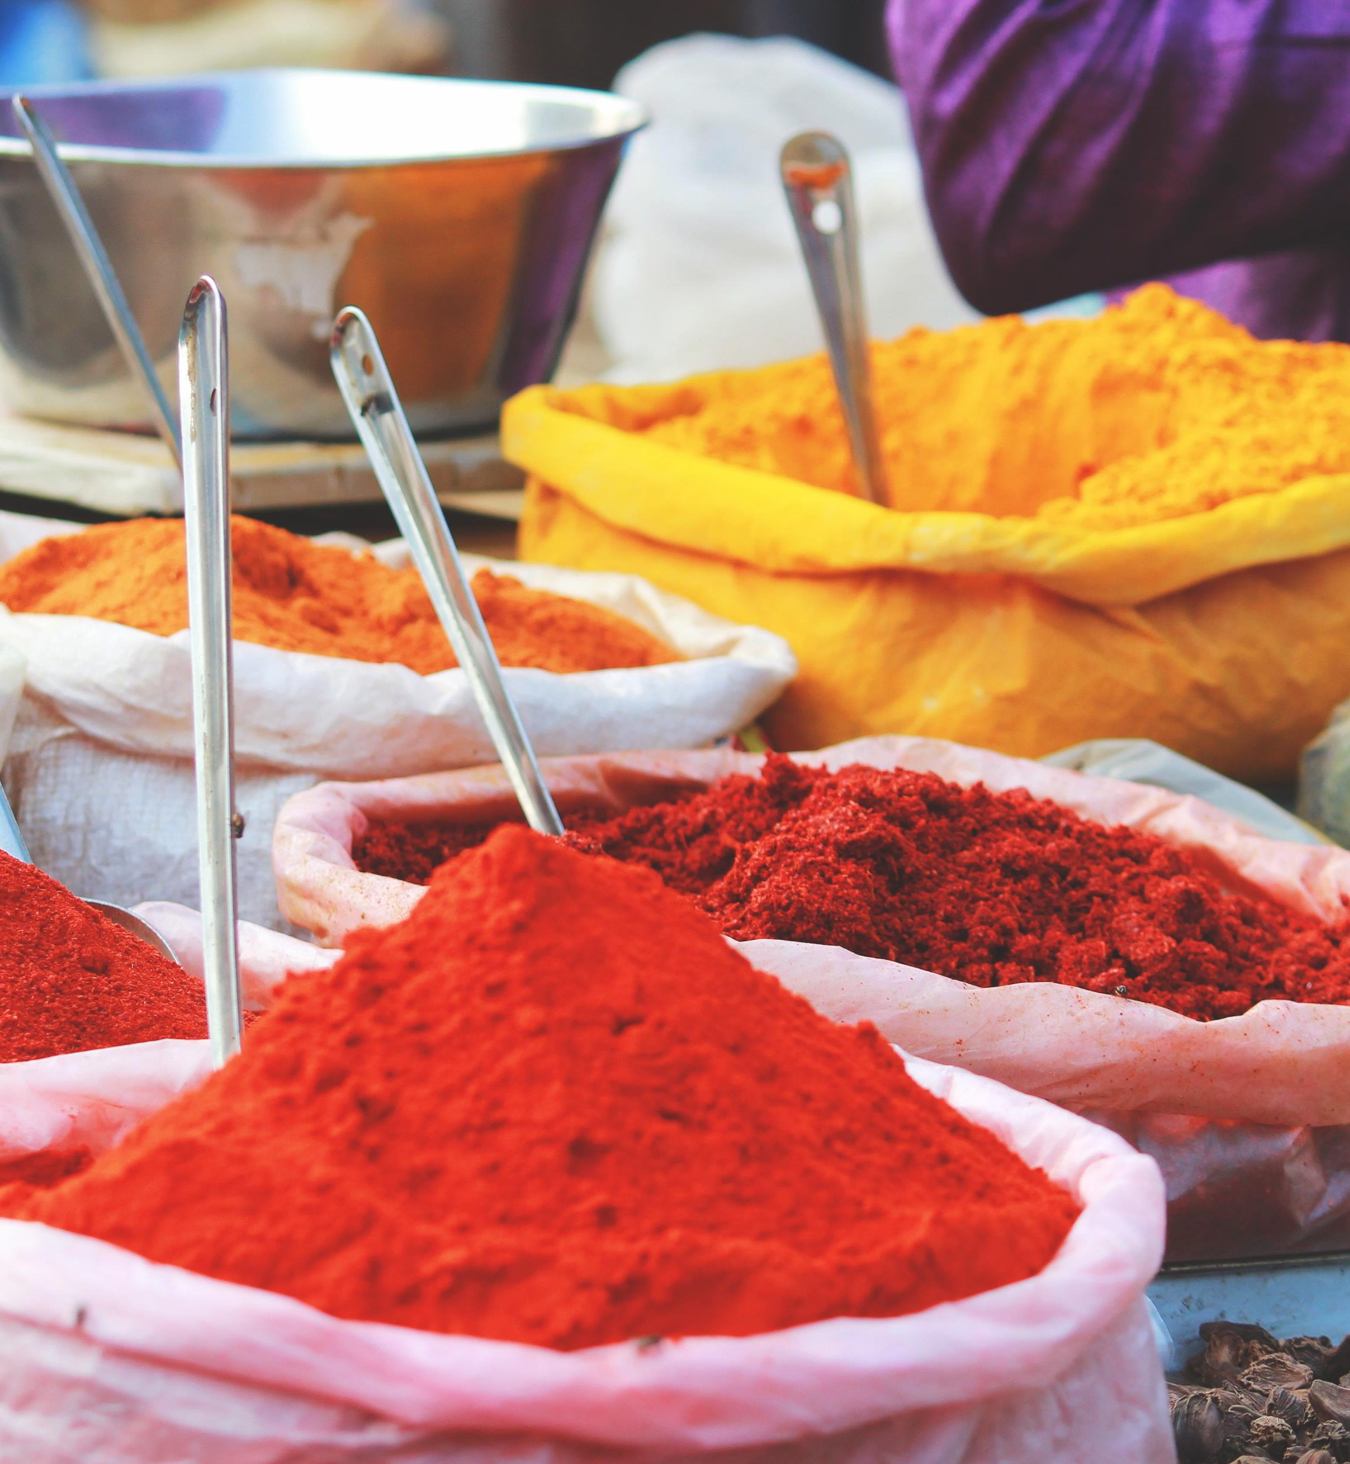
Flavors
TDD, the original
BDD
Unit tests
Integration tests
End to end tests
UI tests
Property-based tests
Notes:
There are probably more: (non)-regression tests, contract tests
I wouldn’t recommend venturing into UI tests if you don’t have enough experience with unit tests first. Even though it’s tempting in legacy projects.
TDD vs BDD: show code

Slide 14
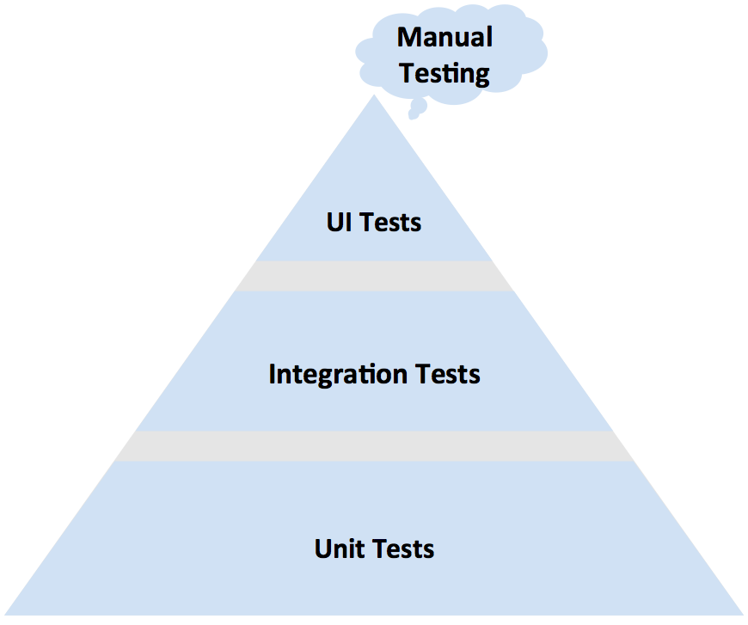
Test pyramid
Notes:
Higher = slower, more brittle, harder to maintain

Slide 15

Difference unit test & integration test?
Notes:
What’s your opinion?
Does it matter? Maybe agree in team.
It was never really defined originally! Unit can be a method, a class, several closely-related classes. Integration can be several classes, several layers/assemblies. Highly personal!

Slide 16

Frameworks
Nunit
MSTest
xUnit.net
SpecFlow
FitSharp
FsCheck
Selenium
Notes:
Selenium: for web apps, there’s also Xamarin Test Cloud,…

Slide 17

xUnit
Fact
Theory
Notes:
Fact = always true, test invariants
Theories = only true for particular set of data
Show DateTimeRangeTests

Slide 18
Better assertions
FluentAssertions
Should
Shouldly
Notes:
Show example of “because …” and failing test

Slide 19

How do we do TDD?

Slide 20
Arrange-act-assert
Notes:
Show Tests project, DiscountCalculatorTests

Slide 21
Naming tests
Notes:
Show Naming project

Slide 22
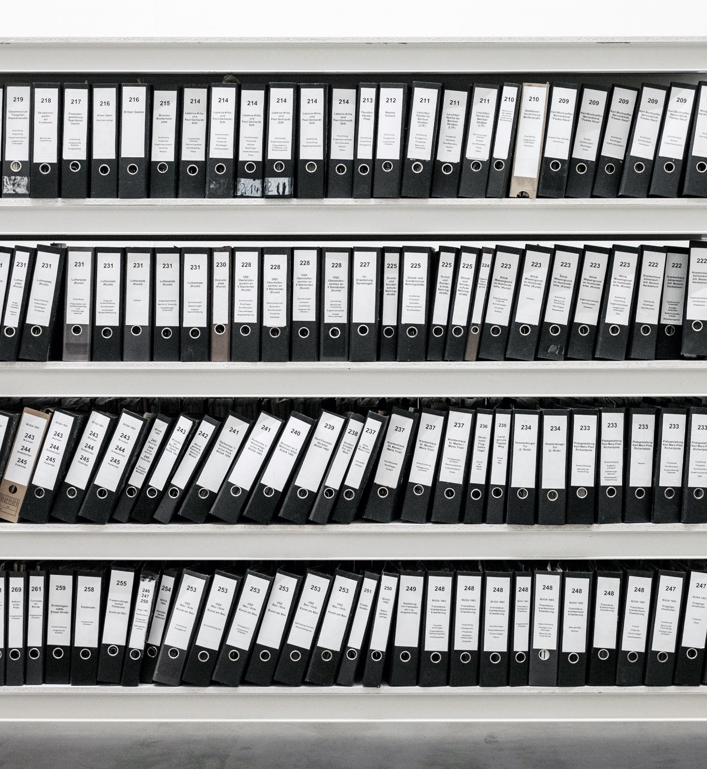
Folder structure
Notes:
Discoverability
Follow folder structure of assembly under test
Harder for integration tests

Slide 23
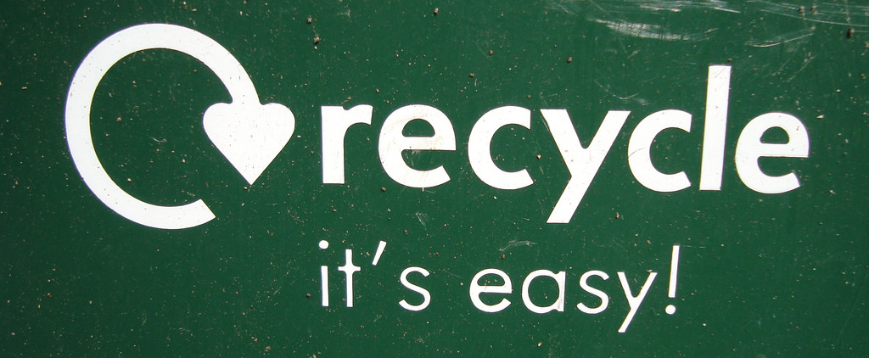
Code reuse
Notes:
CODE (Tests project, Reuse folder)
Inheritance:
Too many paths
Too many places to start looking
Hard to build descriptive names
Builders:
Possibly hides details
Ideally: everything in one test (why xUnit.net doesn’t have SetUp and TearDown, though you can use ctor and Dispose)
=> Keep your tests and classes small!

Slide 24

Keep your tests
Deterministic
Isolated
Readable
Notes:
Readable also means small
If you’re writing large tests, your class under test is probably doing too much (SRP!)

Slide 25

SpecFlow
Gherkin language
Notes:
Show Specs project, write an extra test
Show example of tables: https://github.com/techtalk/SpecFlow/wiki/SpecFlow-Assist-Helpers#createinstance
Talk about tables in steel furnace application

Slide 26
UI tests
Abstract away technical implementation
Be cautious
Notes:
ie: don’t say “when button_login is clicked”, but “when user X logs in”
In my experience: little added value

Slide 27
Property-based tests
Other tests are example-based tests (we provide the exact input)
Notes:
Show PropertyBasedTesting.sln

Slide 28
Disadvantages!
Won’t catch all bugs
Tests need to be maintained too
Externalities are hard to test
Notes:
Won’t catch all bugs: only those you can imagine. Again catching bugs isn’t the biggest advantage
Maintained: just like production code
Externalities: databases, external services, the network,…

Slide 29
Do
Use different techniques (unit tests, integration tests, TDD, BDD,…)
Reproduce bugs
Don’t stress about perfect test suite if you don’t have any tests yet
Keep your tests readable and maintainable
Keep your test styles consistent
Write tests first
Refactor
Include tests in your CI build
Also (often manually) test the bigger picture (external quality!)
Notes:
TDD is not goal in itself (like UML)
Perfect test suite: good tests > bad tests, but bad tests is much better than no tests
Consistency inside a project is more important than lengthy discussions on what the best naming/structure/… is
External quality: does the software do what the user wants it to do?

Slide 30
Don’t
Try to achieve 100% test coverage, that’s just silly
Use inheritance for code reuse
Let your tests know too much of the internal implementation
Test private/internal members
Make tests inter-dependant
Notes:
Test coverage: don’t waste time testing properties. 100% coverage may be interesting for military, medical,…
Inheritance for code reuse: never!

Slide 31

Who is this guy?
Peter Morlion
petermorlion.com
@petermorlion
❤ legacy code

